Slide 1

ANALOG NEURAL NETWORK FOR MNIST DATASET
INSTRUCTOR: DR. CHETAN SINGH THAKUR
AASHEIK SARAN S
ABHISHEK SESHAN K
HARIRAM P

Slide 2

CONTENTS
PROBLEM STATEMENT
SOFTWARE MODEL
RESULTS – SOFTWARE MODEL
VERILOGA – RESULTS
HARDWARE DESIGN FLOW
PROPOSED ARCHITECTURE
CIRCUIT DIAGRAM
CADENCE RESULTS
CONCLUSION

Slide 3
PROBLEM STATEMENT
This project explores the implementation of an Analog Neural Network trained on the MNIST dataset. The MNIST dataset consists of 28x28 grayscale images of handwritten digits (0–9). In this approach, the neural network is first trained in software, and the learned weights are then mapped to an analog hardware architecture in Cadence Virtuoso(180nm).
For Hardware Model, We are using 5x5 grayscale image to classify MNIST dataset.

Slide 4
SOFTWARE MODEL
WEBSITE LINK
https://aasheik.streamlit.app/
ANN LAYER | FUNCTION | SIZE
INPUT LAYER | Takes Analog Input and performs Weighted Average | 784
HIDDEN LAYER | Activation of Weighted Sum | 130
OUTPUT LAYER | Compute Final Class Scores (0–9 digits) | 10

Slide 5
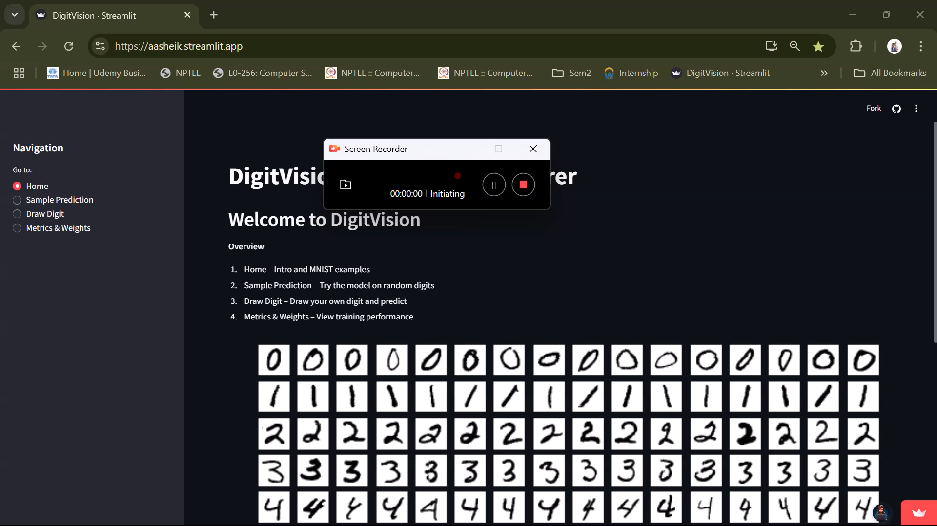
SOFTWARE MODEL

Slide 6
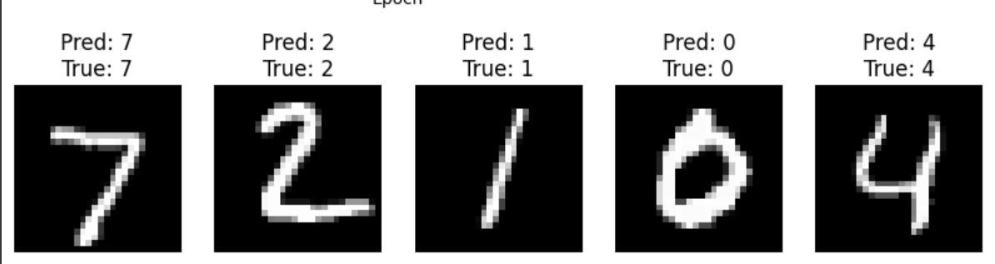
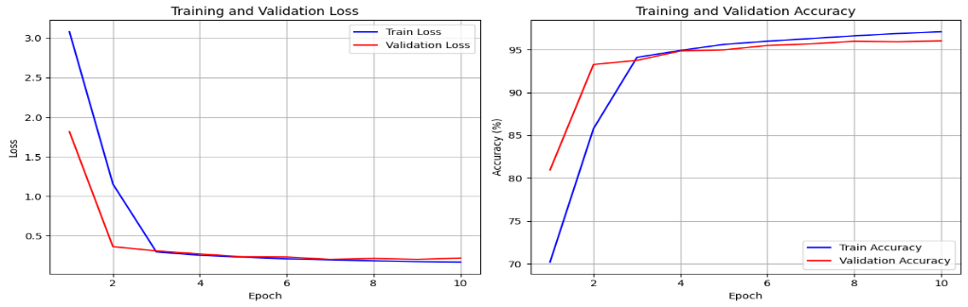
Results: software model

Slide 7
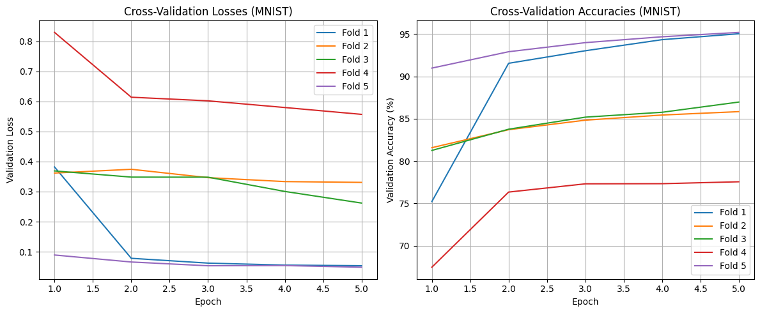
Results: software model
Validation loss decreases consistently across all folds, indicating effective learning.
Fold 5 performs best with highest accuracy (~95%) and lowest loss.
Fold 4 performs worst showing lowest accuracy (~75%) and highest loss.

Slide 8
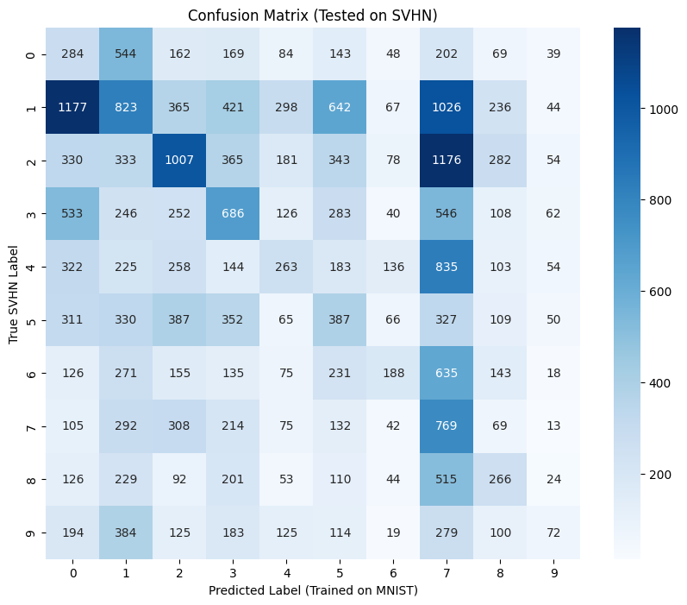
Results: software model

Slide 9
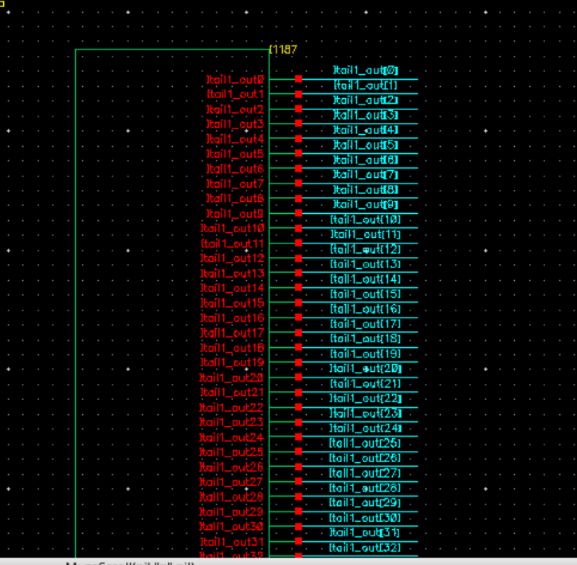
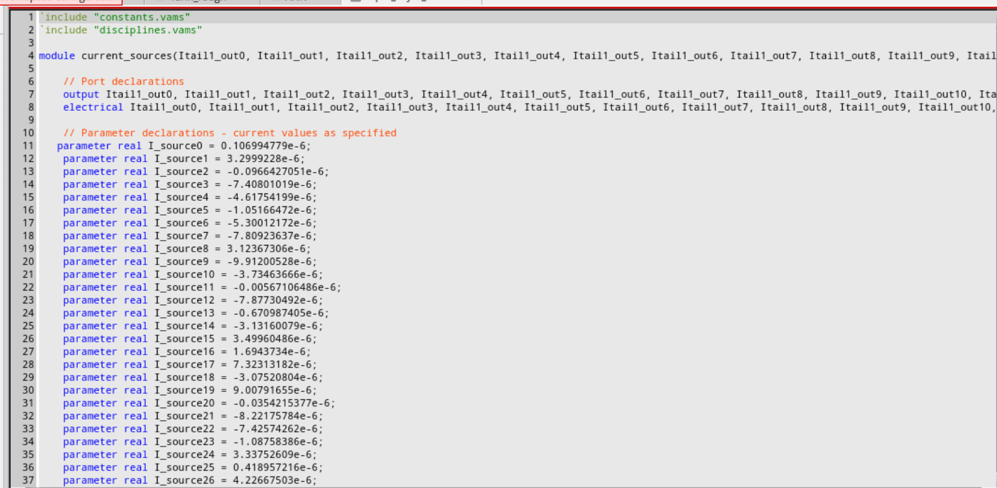
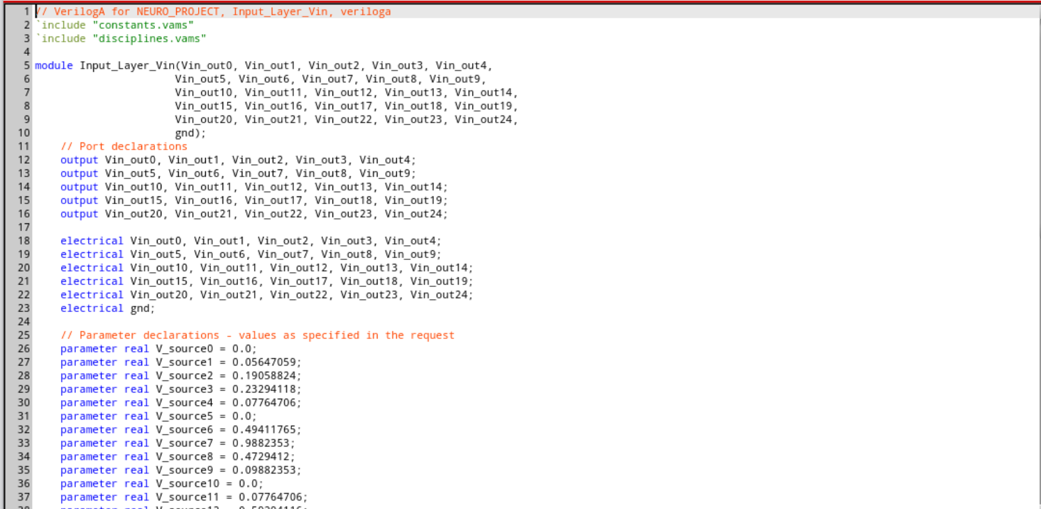
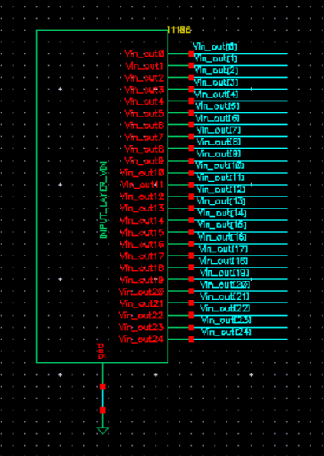
Verilog a results

Slide 10
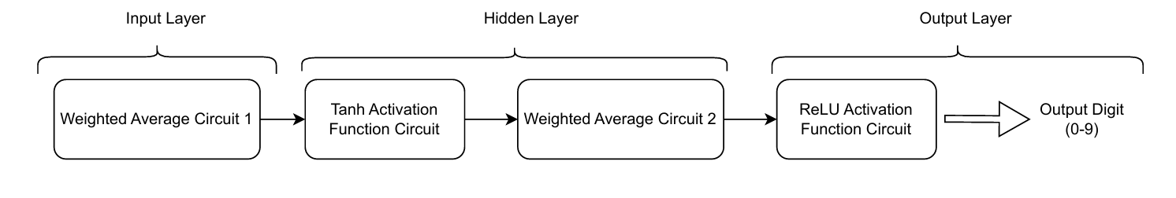
HARDWARE DESIGN FLOW
OP1
OP2
V(0-9)

Slide 11
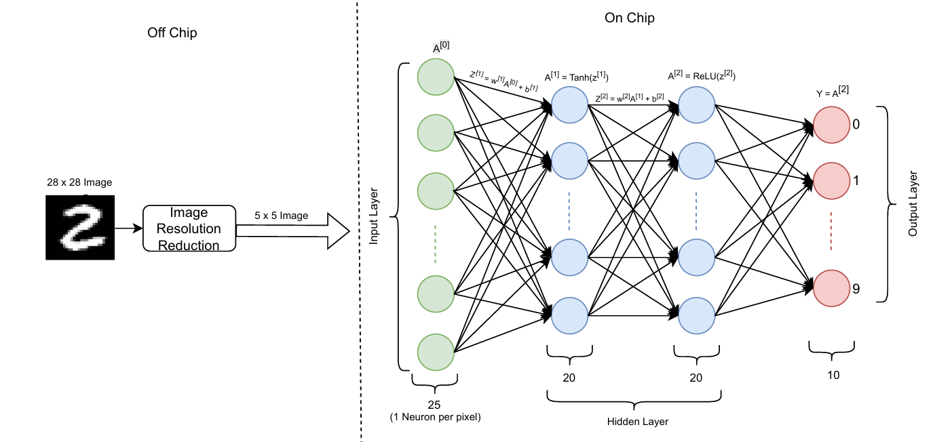
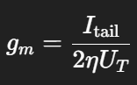
PROPOSED ARCHITECTURE
Weights are represented as gm​, which are then converted into current and fed into the circuit using VerilogA.
Positive and negative weights are managed by controlling the current flow using PMOS.

Slide 12
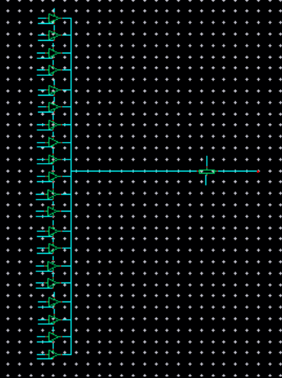
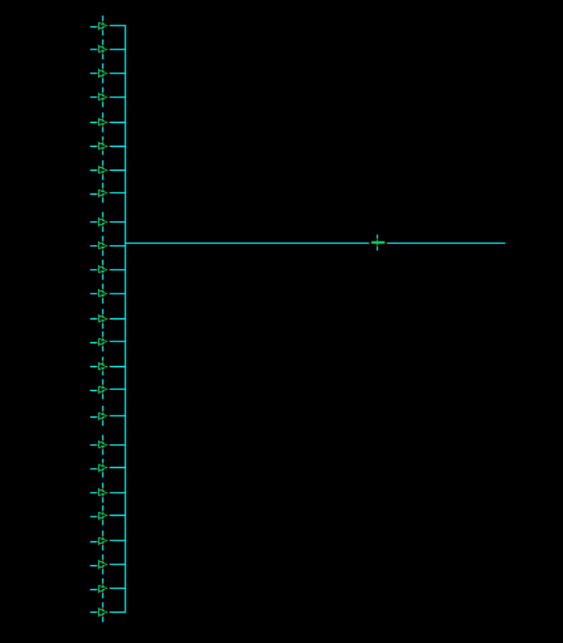
CIRCUIT Diagram: top level schematic
Number of OTAs Used
Input Layer: 500 Hidden to Output Layer: 200
ANN LAYER | FUNCTION | SIZE
Input Layer | Weighted Average | 25
Hidden Layer | Tanh Activation + Weighted Average | 20
Output Layer | ReLU Activation | 10

Slide 13
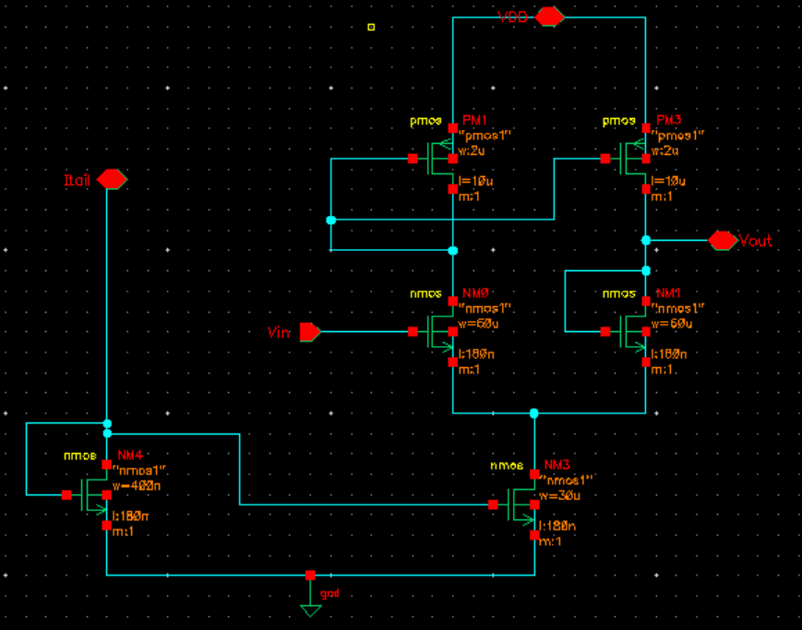
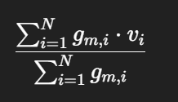
Circuit diagram: WEIGHTED average
EQUATION USED
REGION OPERATED : SUBTHRESHOLD - SATURATION REGION

Slide 14
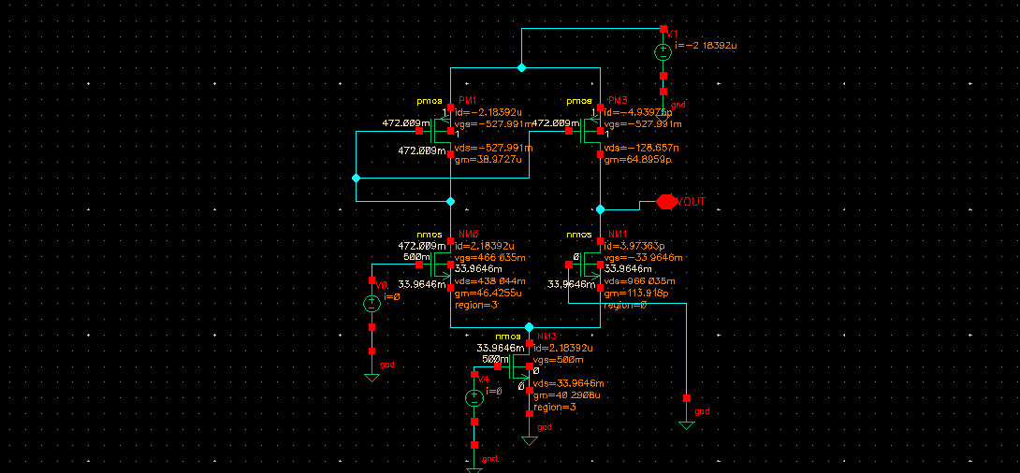
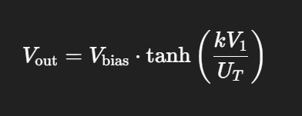
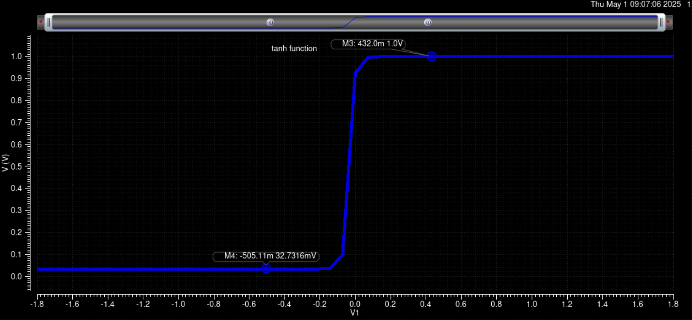
CIRCUIT Diagram: activation function
EQUATION USED
REGION OPERATED :
SUBTHRESHOLD - SATURATION REGION

Slide 15
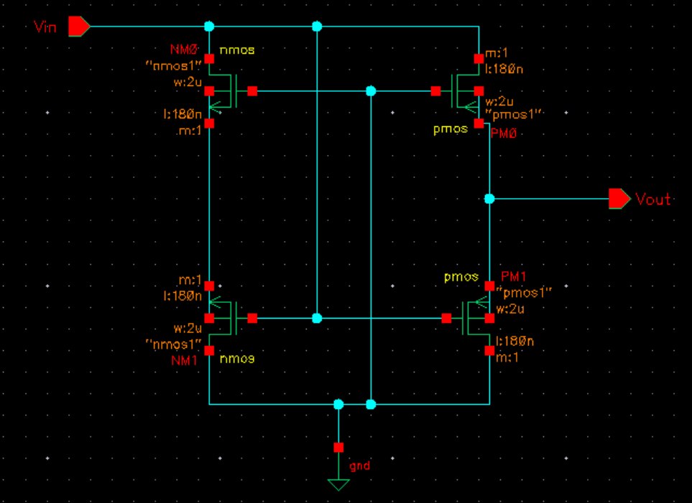
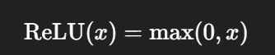
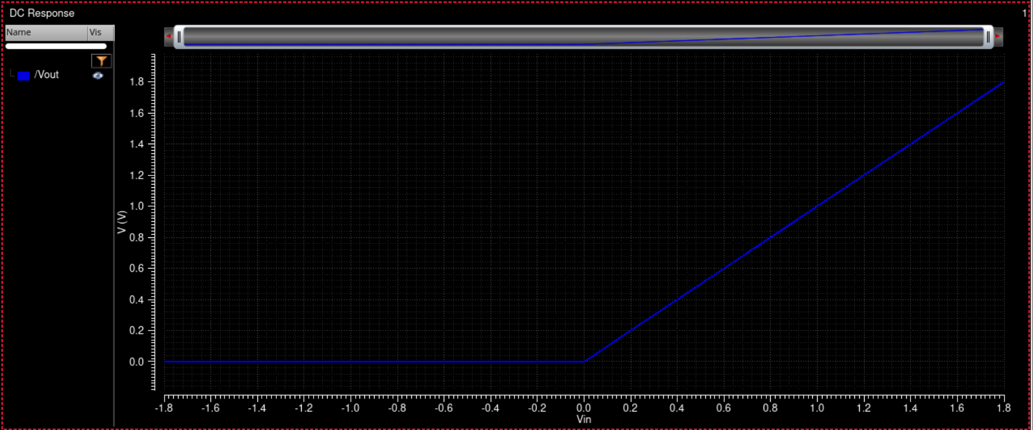
CIRCUIT Diagram: relu activation function
EQUATION USED

Slide 16
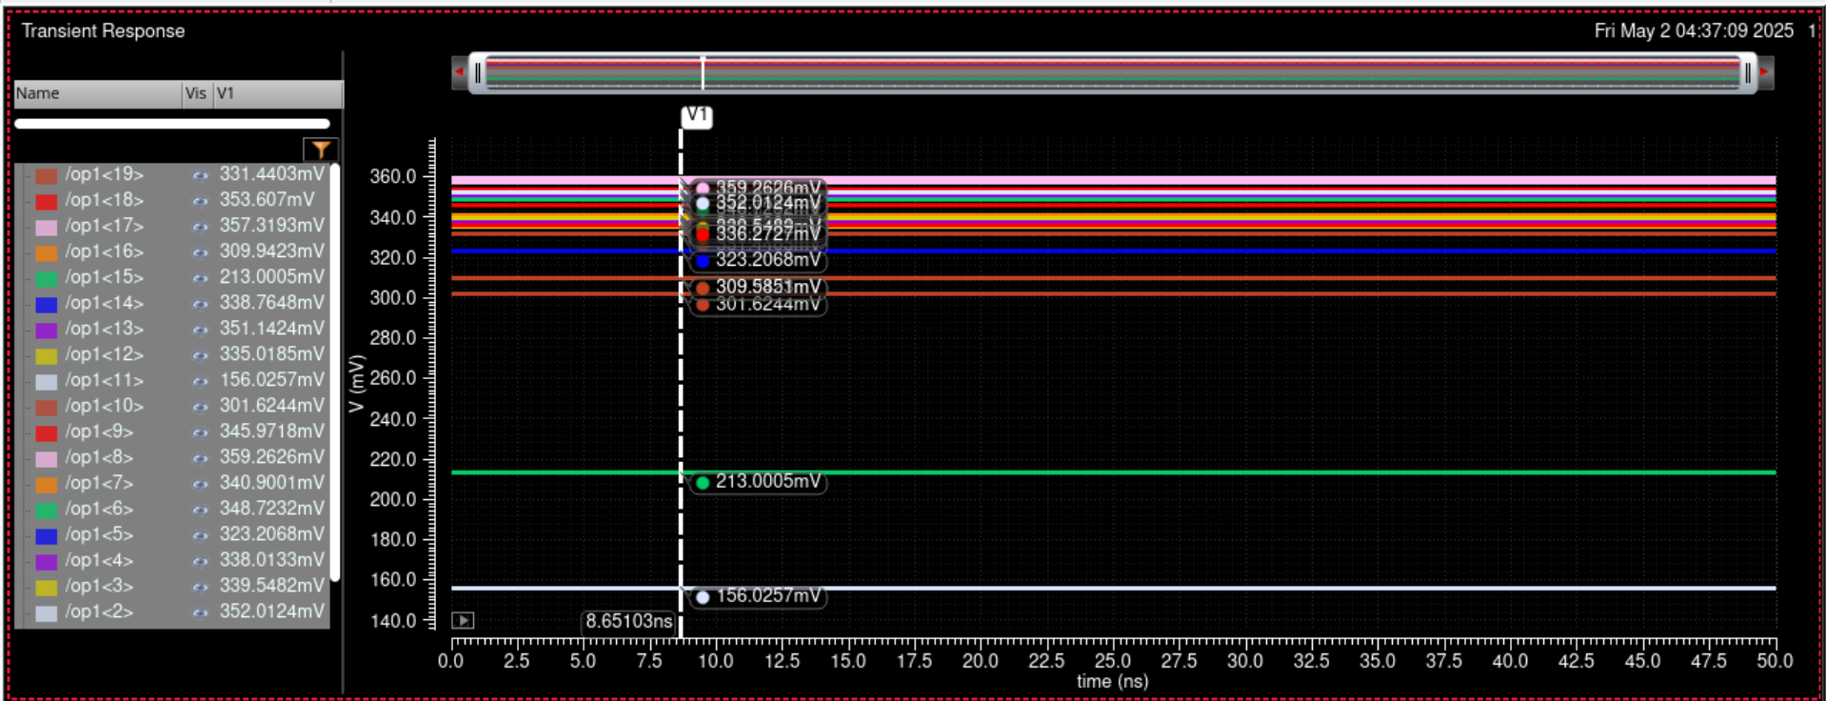
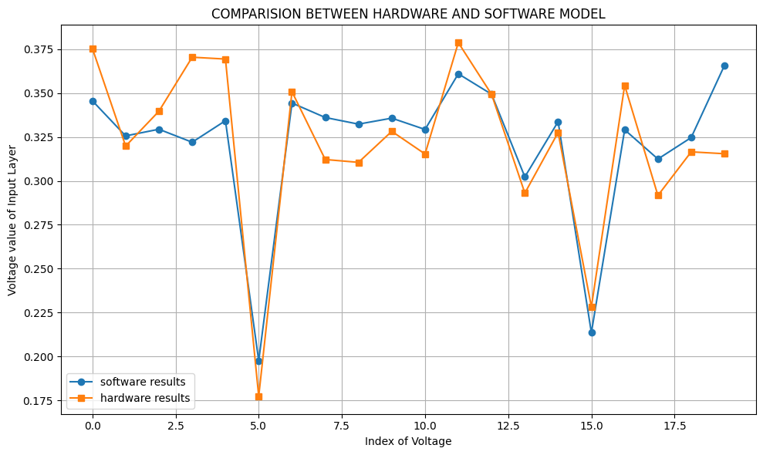
Cadence RESULTS: DIGITʻ6ʼ LABEL

Slide 17
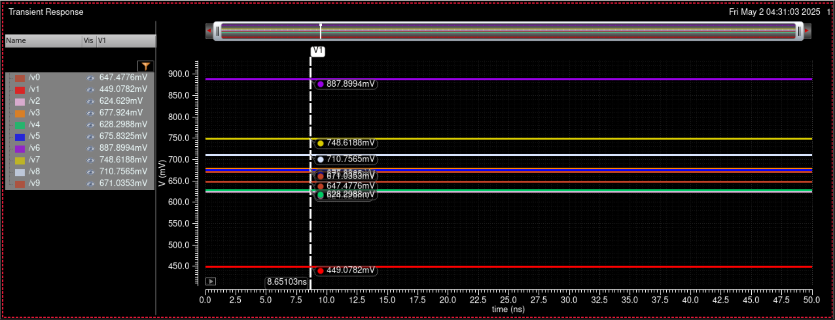
CADENCE RESULTS: digitʻ6’ label

Slide 18
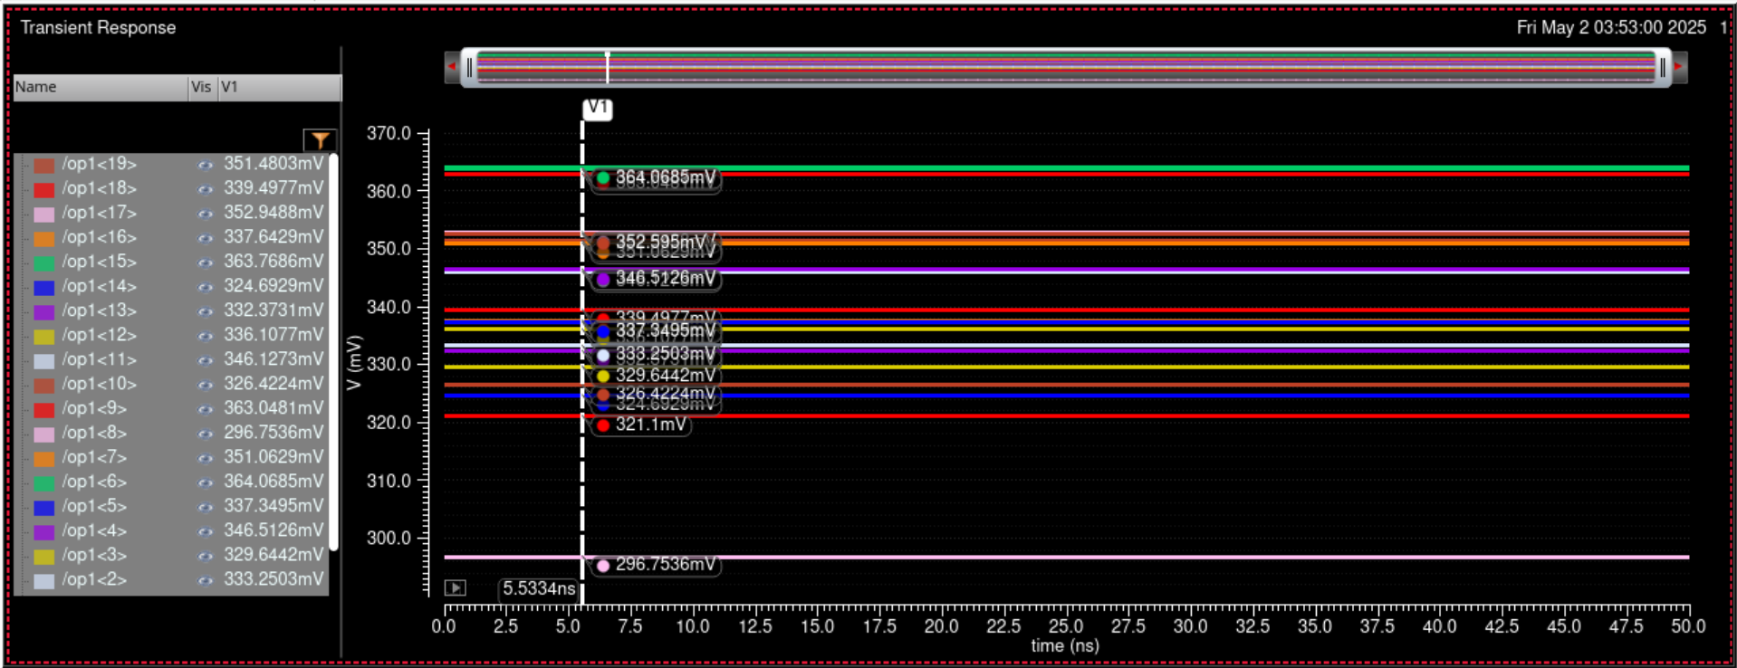
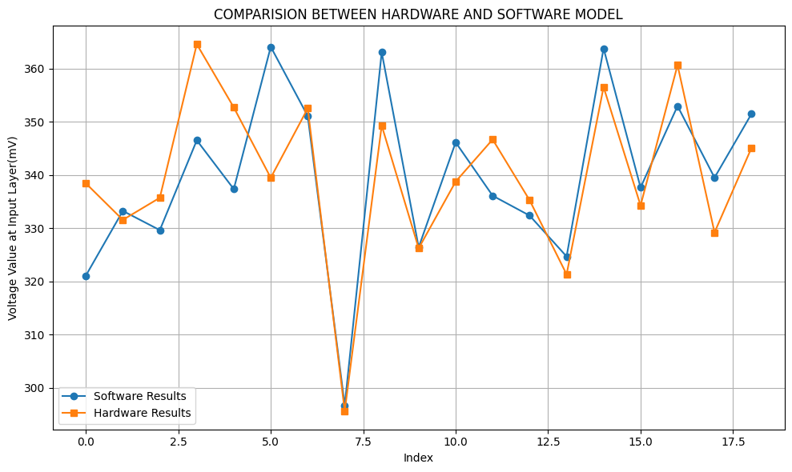
CADENCE results: digit ʻ1’ label

Slide 19
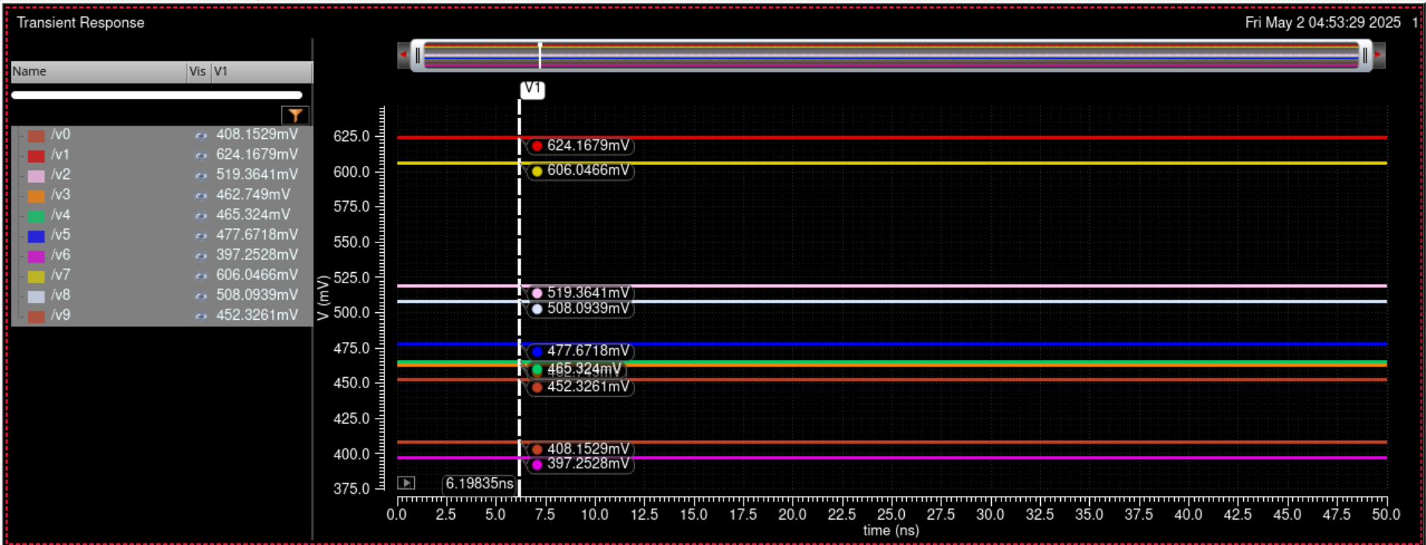
CADENCE results: digit ʻ1’ label

Slide 20
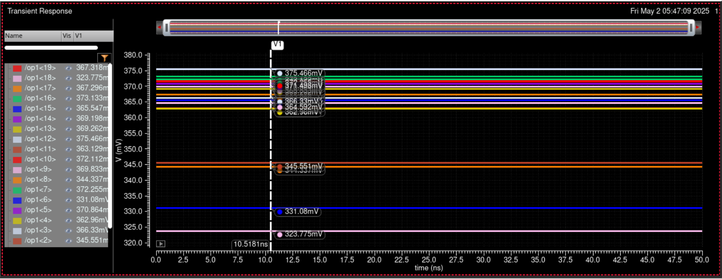
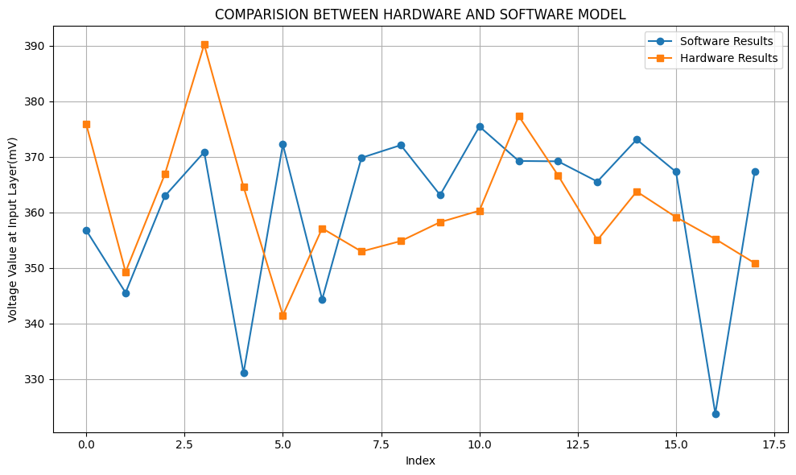
Cadence results: digit ʻ9’ label

Slide 21
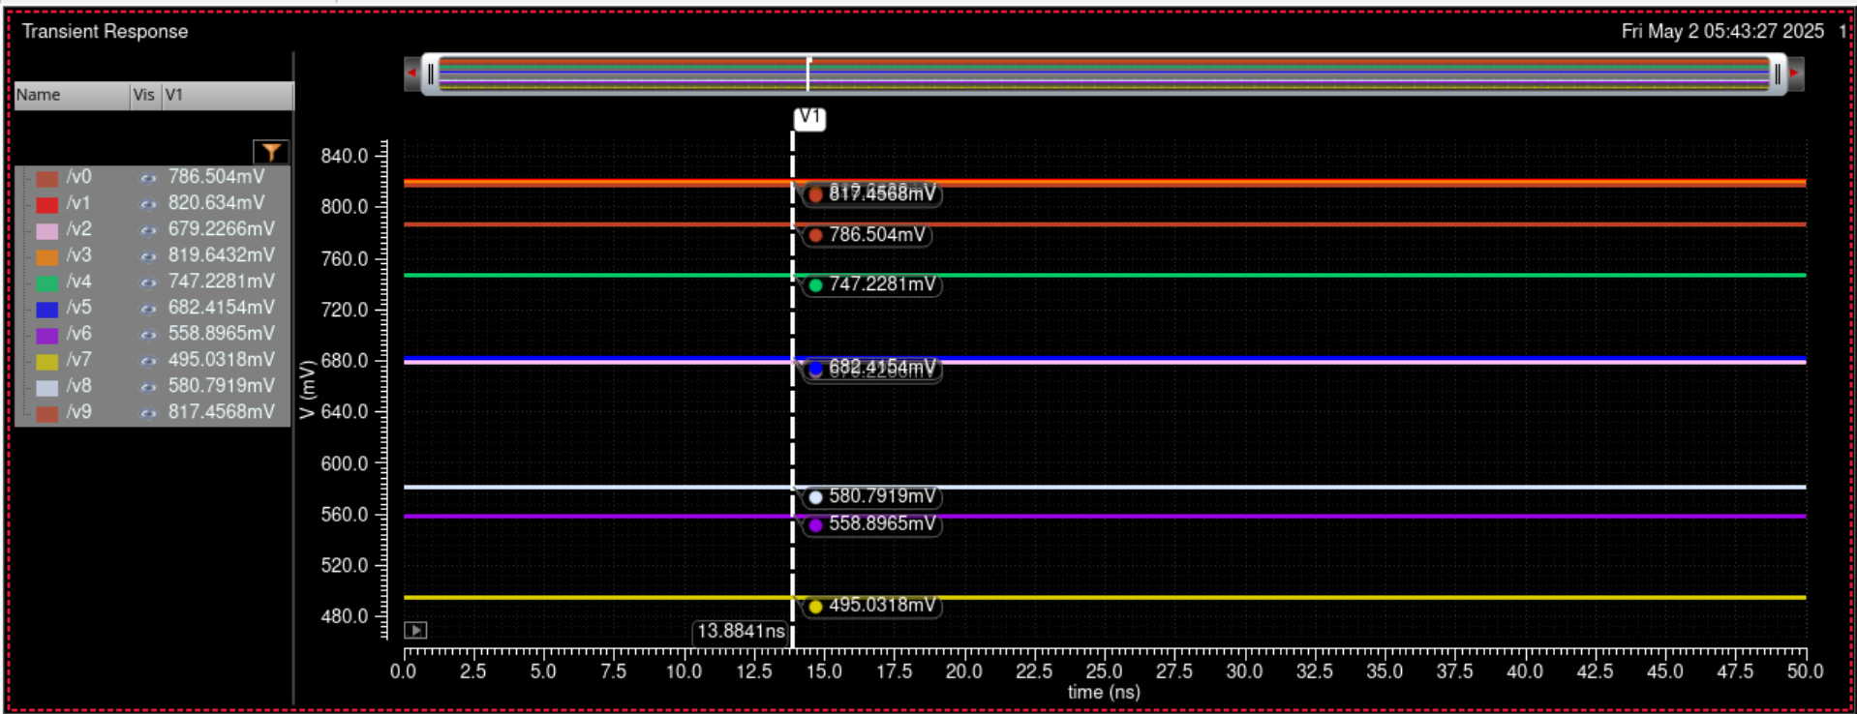
CADENCE results: digit ʻ9’ label

Slide 22
CONCLUSION
An analog neural network was implemented to classify handwritten digits from the MNIST dataset. The model was first developed and validated in software using standard machine learning tools, achieving 93% accuracy. This served as a reference for the hardware implementation, where the network was realized at the transistor level. VerilogA was used solely to feed the output weights from the Python model as input currents into the Cadence simulation environment.
The hardware simulation achieved 67.67% accuracy, with the performance drop attributed to analog non-idealities such as device mismatch, thermal noise, limited linearity, and current mirroring errors. Despite this, the approach highlights the potential for low-power with scope for further optimization.

Slide 23

THANK YOU

